Slide 1
Zoom Video Webinar Housekeeping Slides
Add and customize the following slide to your webinar presentation deck to demonstrate the following:
Adjust VoIP audio settings
Raise hand
Submit questions to Q&A
Please view the notes on the following slide for a step-by-step guide to the animations.

Slide 2
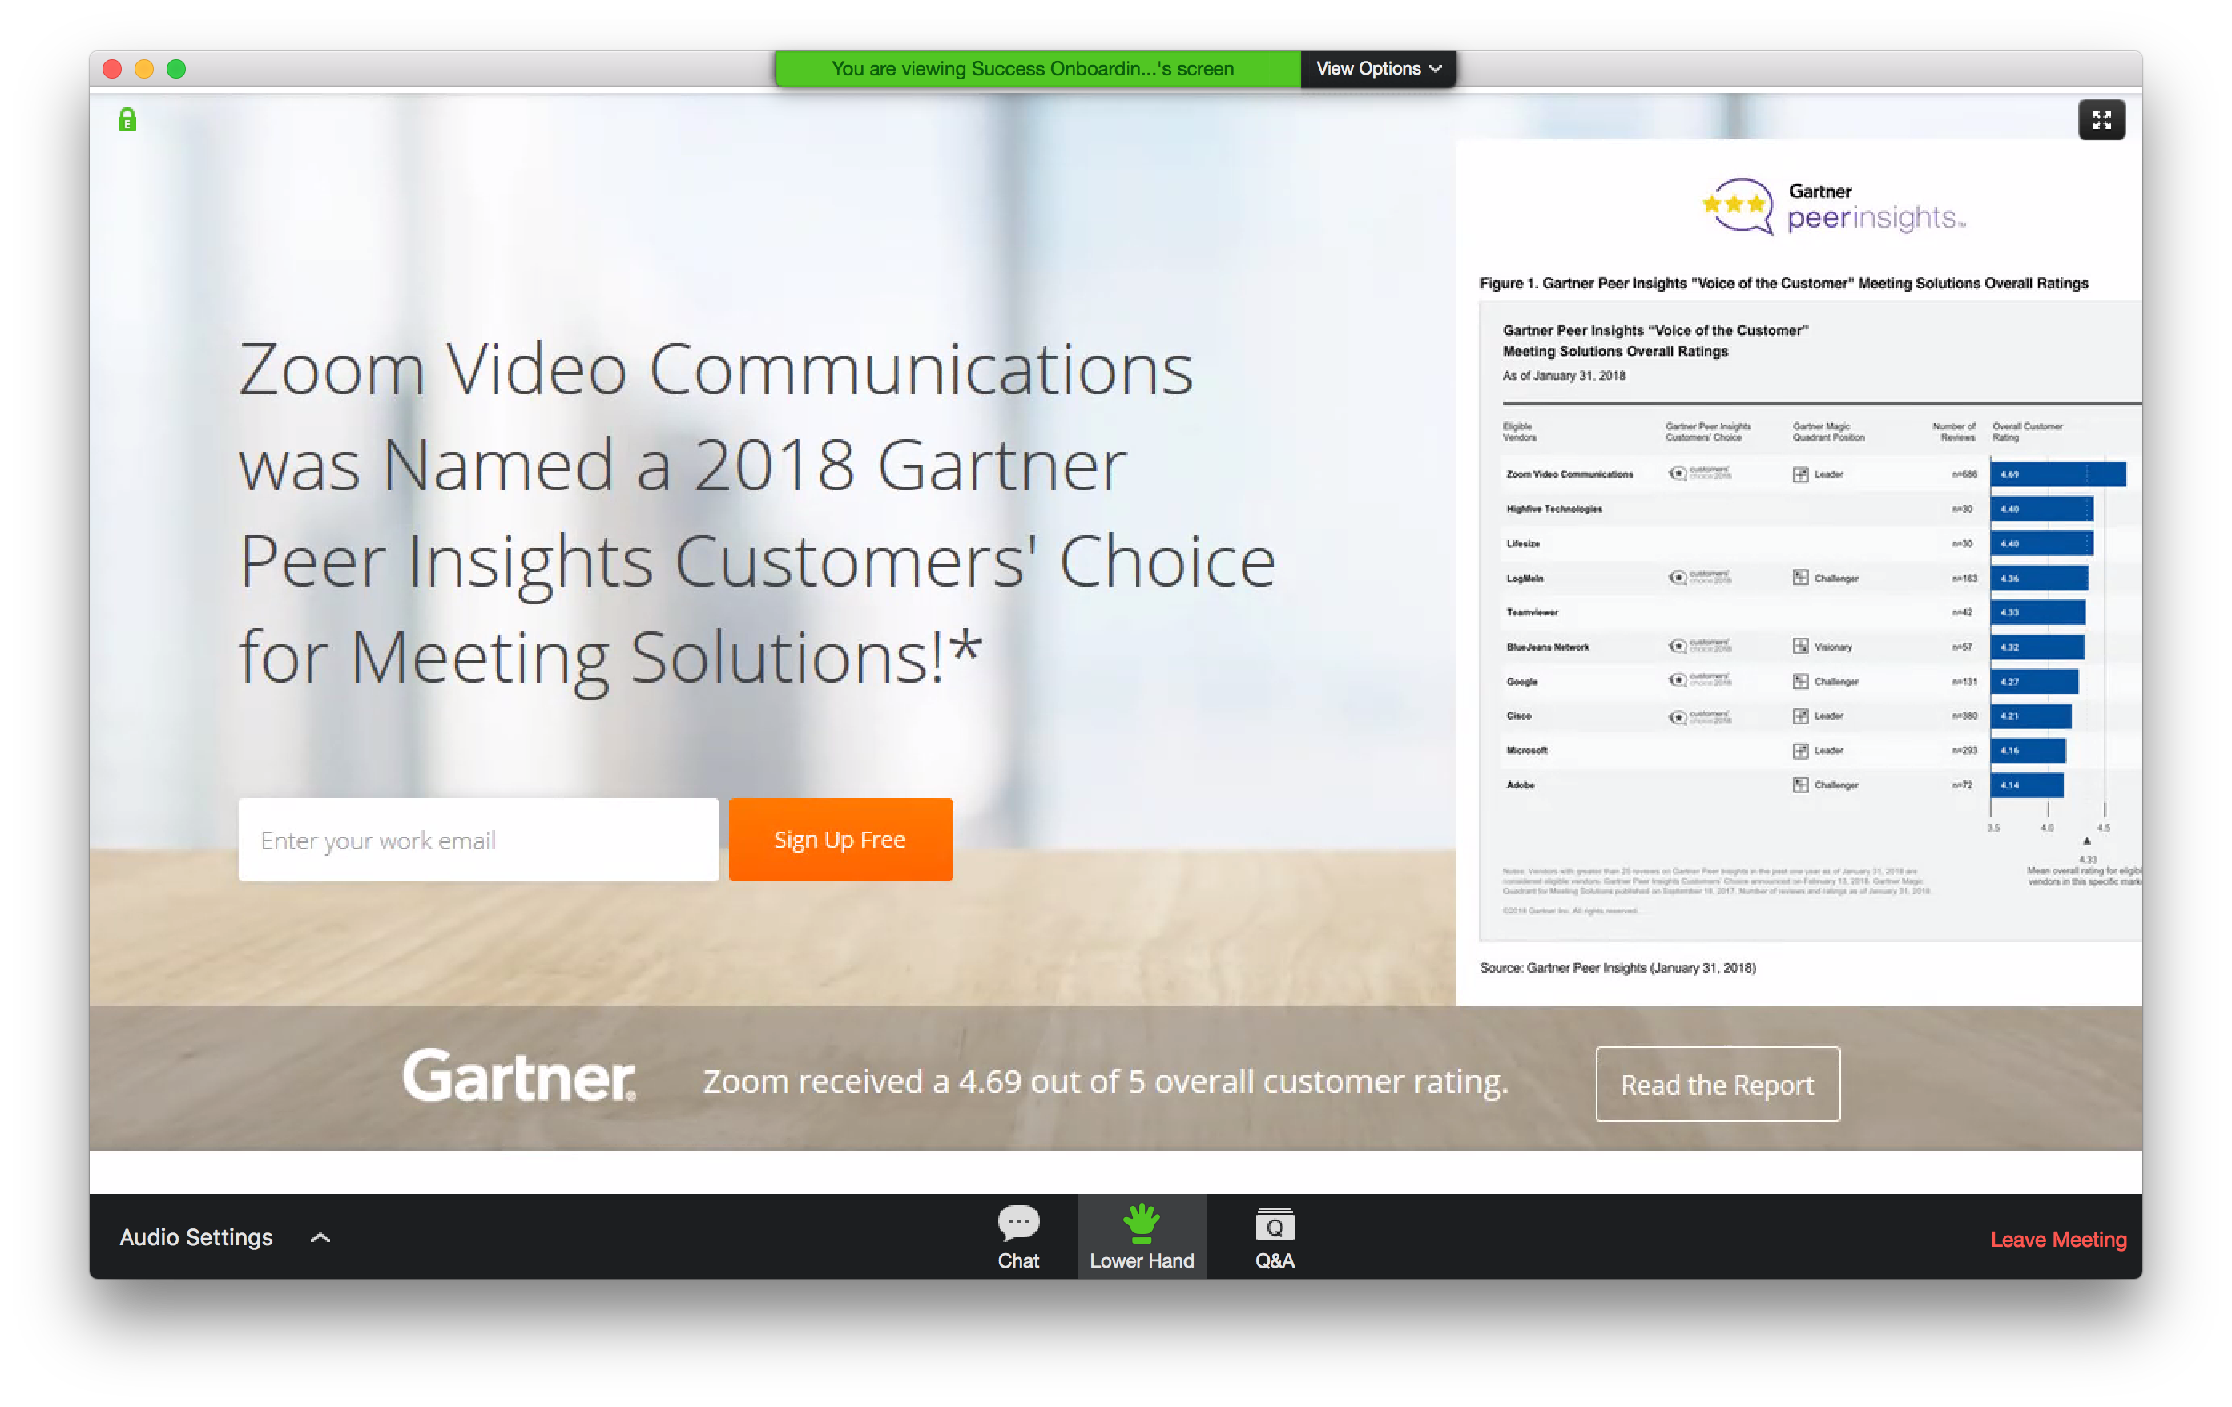
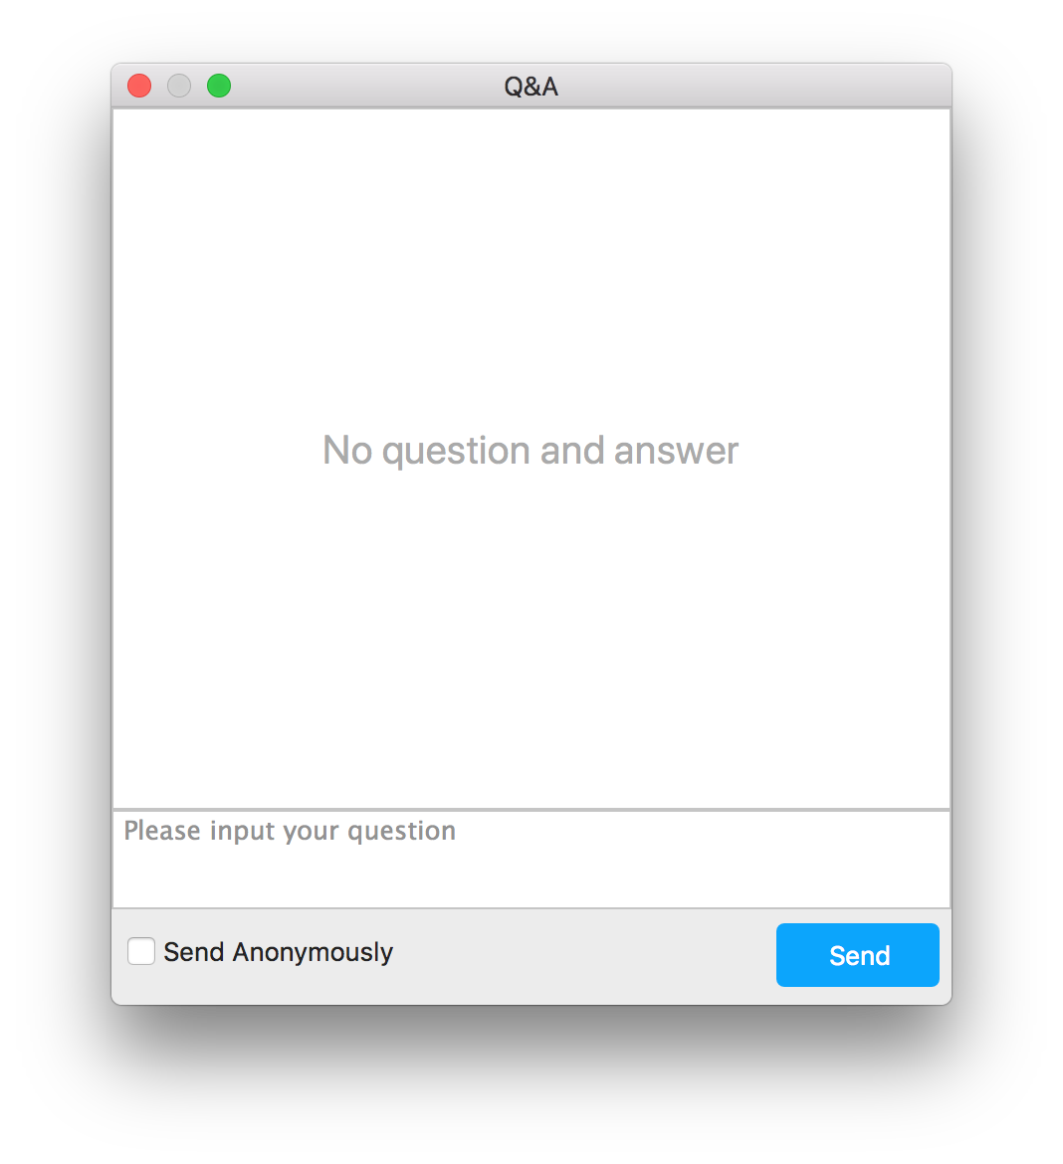
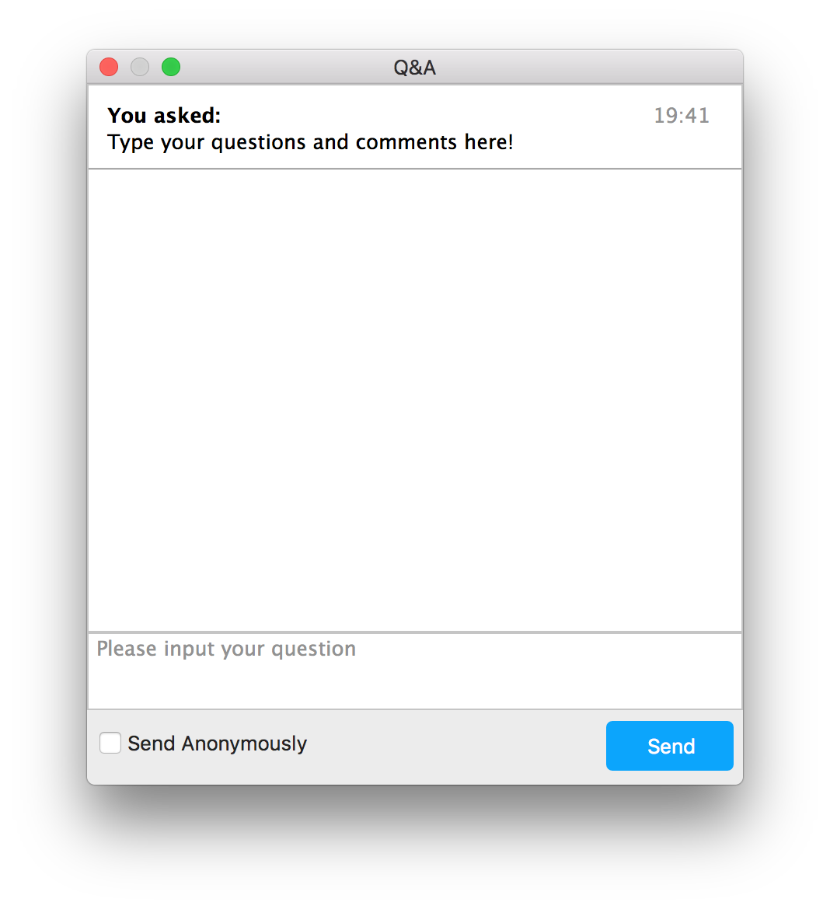
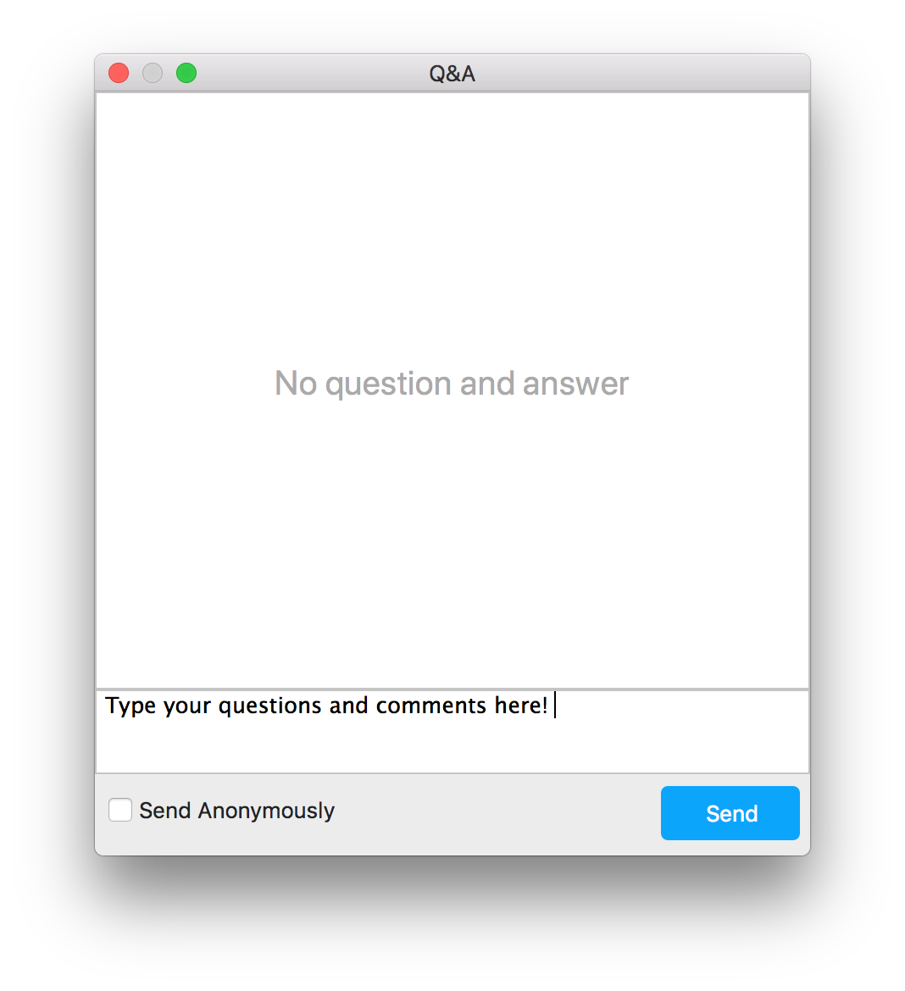
Webinar participation
Notes:
Meeting v. Webinar Comparison
https://support.zoom.us/hc/en-us/articles/115005474943-Meeting-and-Webinar-Comparison

